Slide 1

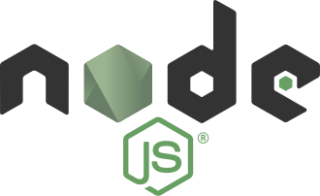
Shun-Yun Hu
Imonology Inc.
2017-06-04

Slide 2


about me
Researcher on scalable virtual worlds
Co-founder of Imonology Inc. (意門科技)
Dad of two veggie kids

Slide 3
structure
Class 1
  node.js intro & install (HTTP server)
  Javascript callbacks (directory viewer)
  Express intro & install (login)
Class 2
  MongoDB intro
  Scalra intro (login)
  npm module (flexform)

Slide 4

node.js
2009 by Ryan Dahl
Server-side JavaScript
Powered by Google’s V8
Event-driven
Asynchronous I/O (non-blocking)
Real-time Web-apps
npm: 450,000 projects, 2 billion weekly downloads

Slide 5

express
2010 by TJ Holowaychuk
Fast, unopinionated, minimalist web framework
Server MVC architecture
Works with templating language (EJS, Jade, ..)
Installation
  npm install express

Slide 6


MongoDB
2007 by Double-click founders Dwight Merriman, Kevin Ryan
NoSQL DB
JSON-like documents with schemas

Slide 7
Let’s Review First

Slide 8


check installation

Slide 9
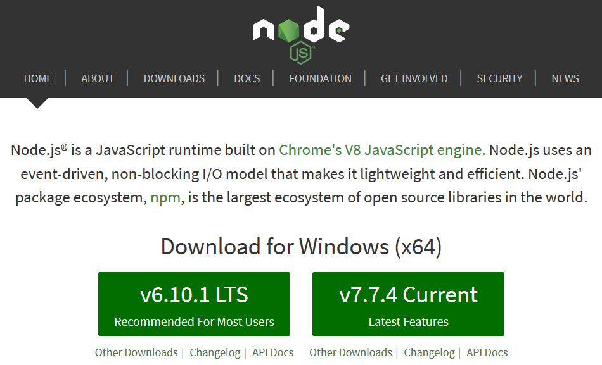
Installation (nodejs.org)

Slide 10
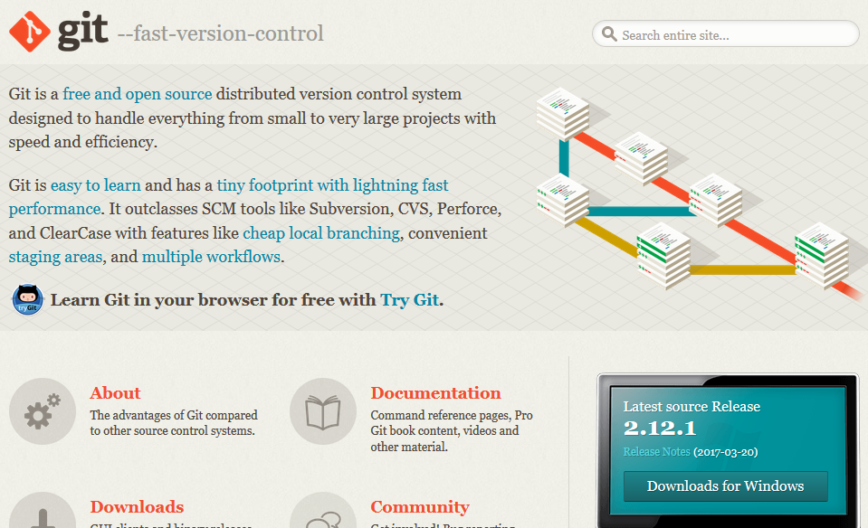
Git (git-scm.com)

Slide 11
Get tutorial
git clone https://github.com/syhu/node-express-tutorial.git
cd node-express-tutorial
npm install express
npm install ejs
npm install body-parser

Slide 12
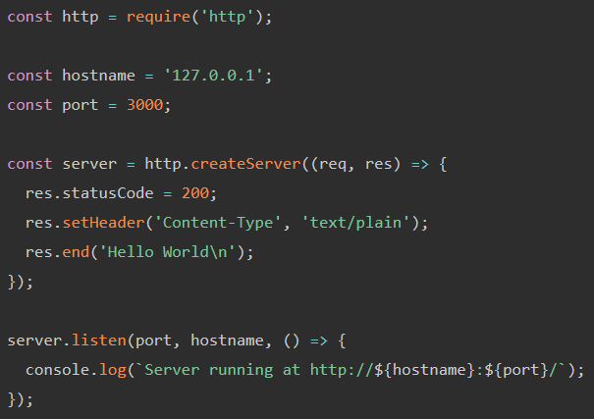
HTTP server (https://nodejs.org/en/about/)
1-http.js

Slide 13
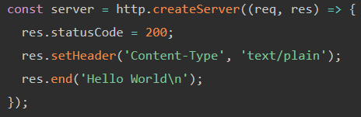
Callback

Slide 14
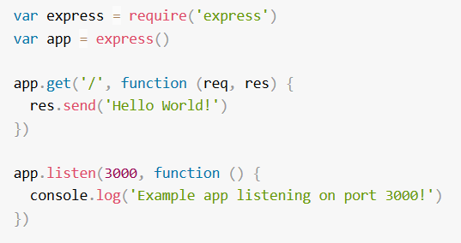
express: “Hello world” (5-express-app.js)

Slide 15
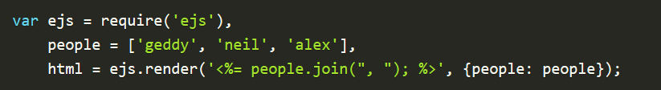
EJS (“effective” JS)
Installation
  npm install ejs

Slide 16
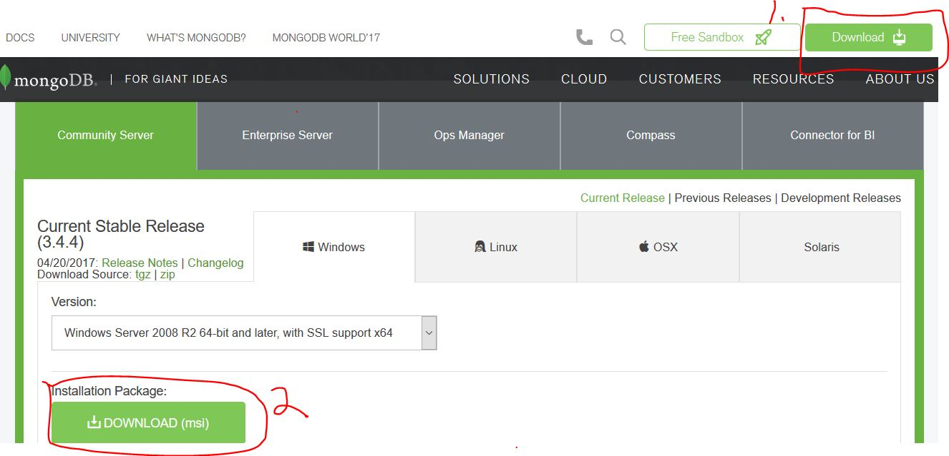
MongoDB (https://www.mongodb.com/)

Slide 17
Init MongoDB
create data directory
  md \test\mongodb\data
Start server
  "C:\Program Files\MongoDB\Server\3.4\bin\mongod.exe" --dbpath d:\test\mongodb\data
Connect to MongoDB
"C:\Program Files\MongoDB\Server\3.4\bin\mongo.exe

Slide 18
Scalra: API prototyping & scaling
Build scalable servers easily
Designed for real-time applications (latency sensitive)
Suited for API server building
One logic for any connection (http/websocket/socket)
In-memory “datastore” to update DB access directly
Pub/sub messaging (channel and spatial data)

Slide 19
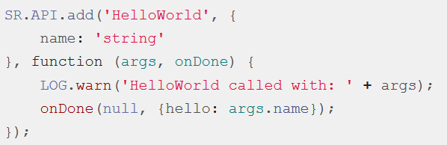
Define API

Slide 20
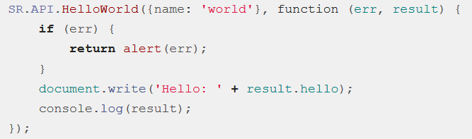
API access
By URL
By function calls

Slide 21
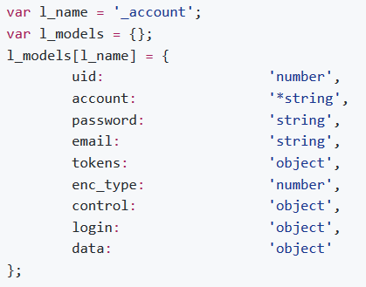
DataStore
In-memory access of DB data directly as variables
Define model:

Slide 22
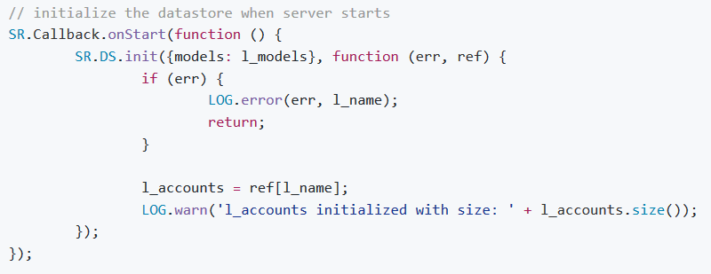
Init DataStore

Slide 23
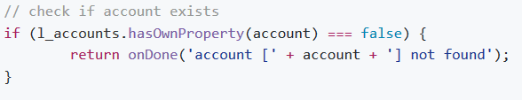
Accessing DataStore

Slide 24
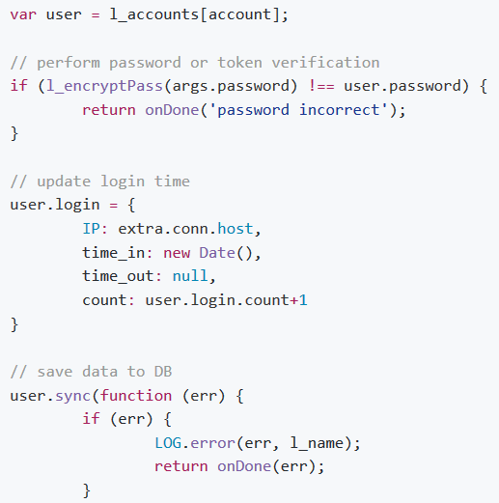
Updating DataStore

Slide 25
Exercises
Modify: e-mail check to account registration
Add: record & update personal info
Your choice..?

Slide 26
Q &A
syhu@imonology.com

